Slide 1
Principles of Parallel and Distributed Computing
Textbook:
Mastering Cloud Computing
– RajKumar Buyya

Slide 2
Parallel Vs Distributed Computing
Parallel: Parallel computing refers to a model where the computation is divided among several processors sharing the same memory.
Homogeneity of components.
Parallel programs are then broken down into several units of execution that can be allocated to different processors and can communicate with each other but means of the shared memory.
Distributed Computing encompasses any architecture or system that allows the computation to be broken down into units and executed on different computing elements, whether these are processors on different nodes, processors on the same computer or cores within the same processor.
Heterogeneity of components.

Slide 3
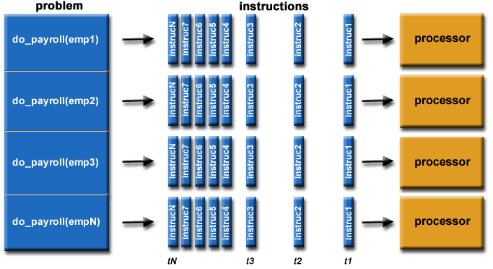
Parallel Computing

Slide 4
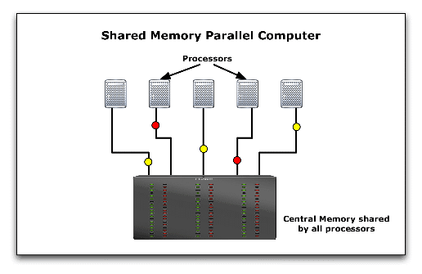
Shared Memory Parallel Computing

Slide 5
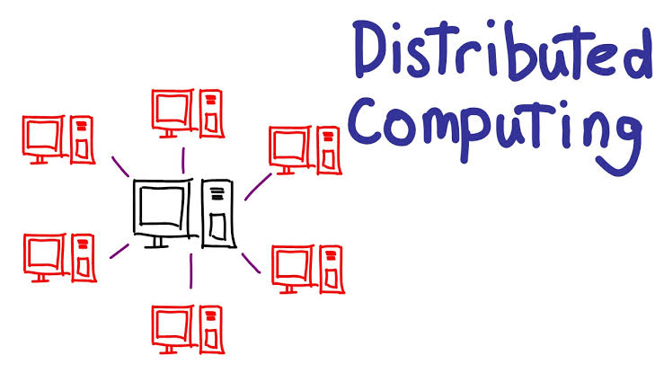

Slide 6
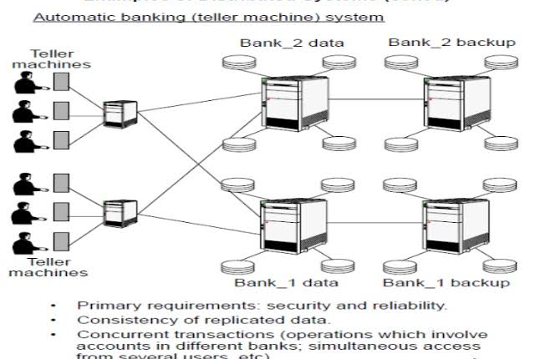
Example for distributed Computing

Slide 7
Elements of Parallel Computing
What is Parallel Computing?
Processing of multiple tasks simultaneously on multiple processors is called parallel processing.
Programming on a multiprocessor system using the divide-and-conquer technique is called parallel programming.
Parallel processing provides a cost-effective solution to this problem by increasing the number of CPUs in a computer and by adding an efficient communication system between them.

Slide 8
Influenced by many factors
Computational requirements are ever increasing in the areas of both scientific and business computing.
Sequential architectures are reaching physical limitations as they are constrained by the speed of light and thermodynamics laws.
Hardware improvements in pipelining, superscalar, and the like are nonscalable and require sophisticated compiler technology.
Vector processing works well for certain kinds of problems. It is suitable mostly for scientific problems (involving lots of matrix operations) and graphical processing. It is not useful for other areas, such as databases.
Significant development in networking technology is paving the way for heterogeneous computing.

Slide 9
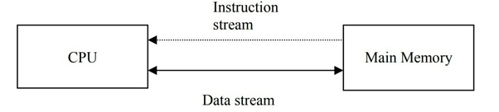
Note:
It can be said that the sequence of instructions executed by CPU forms the Instruction streams and sequence of data (operands) required for execution of instructions form the Data streams.

Slide 10
Hardware architectures for parallel processing
The core elements of parallel processing are CPUs.
Based on the number of instruction and data streams that can be processed simultaneously, computing systems are classified into the following four categories:
• Single-instruction, single-data (SISD) systems
• Single-instruction, multiple-data (SIMD) systems
• Multiple-instruction, single-data (MISD) systems
• Multiple-instruction, multiple-data (MIMD) systems

Slide 11

Single-Instruction, Single-Data (SISD) systems
Uniprocessor machine, single data stream
In SISD, machine instructions are processed sequentially; hence computers adopting this model are popularly called sequential computers.
All the instructions and data to be processed have to be stored in primary memory.
Dominant representative SISD systems are IBM PC, Macintosh, and workstations.
Instruction Stream
Data Input
Processor
Data Output

Slide 12
Single-Instruction Multiple-Data (SIMD) Systems
Multiprocessor machine capable of executing the same instruction on all the CPUs but operating on different data streams.
Well suited to scientific computing since they involve lots of vector and matrix operations.

Slide 13
Single Instruction Stream
Data Input 1
Processor 1
Data Output 1
Processor 2
Data Output 2
Data Input 2
Data Input N
Processor N
Data Output N

Slide 14
Multiple-Instruction, Single-Data (MISD) Systems
Multiprocessor machine capable of executing different instructions on different PEs but all of them operating on the same data set.
MISD model are not useful in most of the applications; a few machines are built, but none of them are available commercially

Slide 15

Instruction
Stream 1
Instruction
Stream 2
Instruction
Stream N
Processor 1
Processor 2
Single Data Input Stream
Single Data Output Stream
Processor N

Slide 16
Multiple-Instruction, Multiple-Data (MIMD) systems:
An MIMD computing system is a multiprocessor machine capable of executing multiple instructions on multiple data sets.
Each PE in the MIMD model has separate instruction and data streams; hence machines built using this model are well suited to any kind of application

Slide 17
Instruction
Stream 1
Instruction
Stream 2
Instruction
Stream N
Data Input 1
Processor 1
Data Output 1
Data Input 2
Processor 2
Data Output 2
Data Input N
Processor N
Data Output 3

Slide 18
MIMD machines are broadly categorized into
Shared-memory MIMD and
Distributed-memory.
Shared memory MIMD machines :
In the shared memory MIMD model, all the PEs are connected to a single global memory and they all have access to it.
The communication between PEs in this model takes place through the shared memory; modification of the data stored in the global memory by one PE is visible to all other PEs (tightly coupled).
Shared memory MIMD systems are Silicon Graphics machines and Sun/IBM’s SMP (Symmetric Multi-Processing).

Slide 19
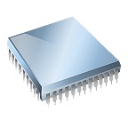

Distributed Memory MIMD Machines:
In the distributed memory MIMD model, all PEs have a local memory. Systems based on this model are also called loosely coupled multiprocessor systems.
The communication between PEs in this model takes place through the interconnection network.
IPC Channel
IPC Channel
Processor 1
Processor 2
Processor N
Processor 1
Processor 2
Processor 2
Memory Bus
Memory Bus
Memory Bus
Memory Bus
Global System Memory
Local
Memory
Local
Memory
Local
Memory

Slide 20
Approaches to Parallel Programming
The most prominent variety of parallel programming approaches are:
Data parallelism: Divide-and-conquer technique; split data into multiple sets, and each data set is processed on different PEs using the same instruction; SIMD model.
Process parallelism: Given operation has multiple (but distinct) activities that can be processed on multiple processors.
Farmer-and-worker model :One processor is configured as master and all other remaining PEs are designated as slaves; the master assigns jobs to slave PEs and, on completion, they inform the master, which in turn collects results.
These approaches can be utilized in different levels of parallelism

Slide 21
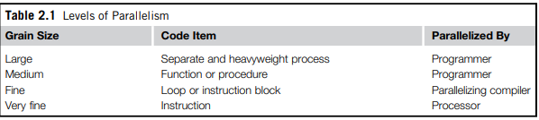
Levels of parallelism
Levels of parallelism are decided based on the lumps of code (grain size) that can be a potential candidate for parallelism.
The idea is to execute concurrently two or more single-threaded applications, such as compiling, text formatting, database searching, and device simulation.

Slide 22

Large grain (or task level)
Medium grain (or control level)
Fine grain (data level)
Very fine grain
(multiple-instruction issue)
Task 1
Messages IPC
Task 2
Messages IPC
Task N
Large Level
(Processes, Tasks)
Function 1
Shared Memory
Function 2
Shared Memory
Function J
function f1()
{…}
function f2()
{…}
function fJ()
{…}
Medium Level
(Threads, Functions)
Statements
Statements
Statements
Fine Level
(Processor, Instructions)
a[0] = …
b[0] = …
a[1] = …
b[1] = …
a[k] = …
b[k] = …
Very Fine Level
(Cores, Pipeline, Instructions)
+
x
load

Slide 23
Laws of caution
What we need to keep in mind is that parallelism is used to perform multiple activities together so that the system can increase its throughput or its speed.
But the relations that control the increment of speed are not linear. For example, for a given n processors, the user expects speed to be increased by n times.
This is an ideal situation, but it rarely happens because of the communication overhead.
Two important guidelines :
• Speed of computation is proportional to the square root of system cost; they never increase linearly. Therefore, the faster a system becomes, the more expensive it is to increase its speed .
• Speed by a parallel computer increases as the logarithm of the number of processors (i.e., y 5 klog(N)).

Slide 24
Elements of distributed computing
General concepts and definitions :
A distributed system is a collection of independent computers that appears to its users as a single coherent system.
- Tanenbaum
A distributed system is one in which components located at networked computers communicate and coordinate their actions only by passing messages.
- Coulouris

Slide 25










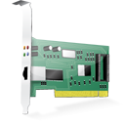
Components of a Distributed System
Frameworks for distributed programming
Applications
Middleware
IPC primitives for control and data.
Operating System
Networking and Parallel Hardware
Hardware

Slide 26
Computer and network hardware constitute the physical infrastructure;
Basic services for inter process communication (IPC), process scheduling and management, and resource management in terms of file system and local devices
At the operating system level, IPC services are implemented on top of standardized communication protocols such Transmission Control Protocol/Internet Protocol (TCP/IP), User Datagram Protocol (UDP) or others.
The middleware layer leverages such services to build a uniform environment for the development and deployment of distributed applications.
The middleware develops its own protocols, data formats, and programming language or frameworks for the development of distributed applications.
The top of the distributed system stack is represented by the applications and services designed and developed to use the middleware.

Slide 27




Social Networks, Scientific Computing, Enterprise Applications
Applications (SaaS)
Frameworks for
Cloud Application Development
Middleware (PaaS)
Virtual hardware, networking, OS images, and storage.
Hardware and OS (IaaS)

Slide 28
Architectural styles for distributed computing
The middleware layer is the one that enables distributed computing, because it provides a coherent and uniform runtime environment for applications.
Architectural styles are mainly used to determine the vocabulary of components and connectors that are used as instances of the style together with a set of constraints on how they can be combined.
Architectural styles for distributed systems are helpful in understanding the different roles of components in the system and how they are distributed across multiple machines.
The architectural styles into two major classes:
Software architectural styles
System architectural styles

Slide 29
Component and connectors
A component represents a unit of software that encapsulates a function or a feature of the system.
Examples of components can be programs, objects, processes, pipes, and filters
A connector is a communication mechanism that allows cooperation and coordination among components.
Software architectural styles :
Software architectural styles are based on the logical arrangement of software components.

Slide 30
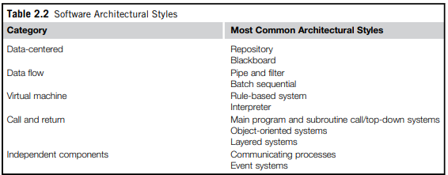
According to Garlan and Shaw , architectural styles are classified as shown in Table :

